Slide 1


P.S.English Medium School, Solapur
Std 8th
Sub : Science

Slide 2
6. Composition of matter
Can You recall?

Slide 3
Can You recall?
1. What are the various states of matter?
The various states of matter are solid, liquid & gas

Slide 4
Can You recall?
2. What is the difference in ice, water and steam?
Ice, water & steam are in different state. i.e. solid, liquid & gaseous respectively.

Slide 5
Can You recall?
3. What are the smallest particles of matter called?
The smallest particles of matter are called atoms.

Slide 6
Can You recall?
4. What are the types of matter ?
The types of matter are elements, compounds & mixture.

Slide 7
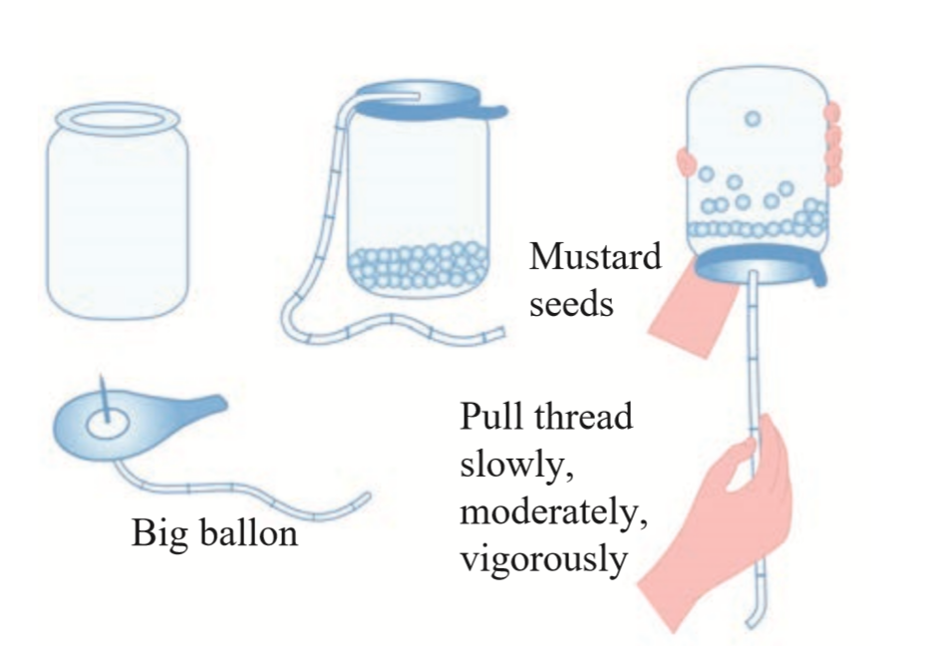
Activity :
Movement of mustard seeds

Slide 8
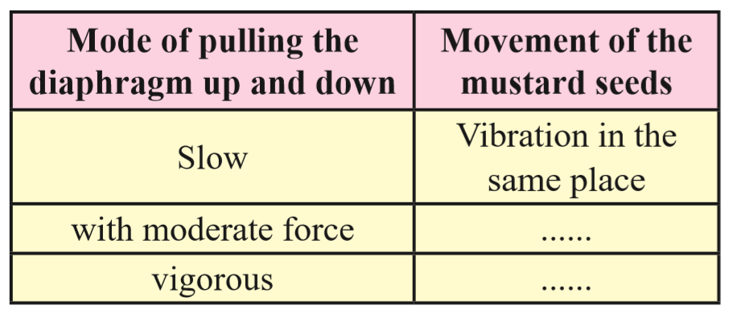
Activity :
Vibration in different places
Vibration all over the jar
Movement of mustard seeds

Slide 9
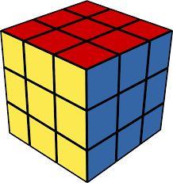
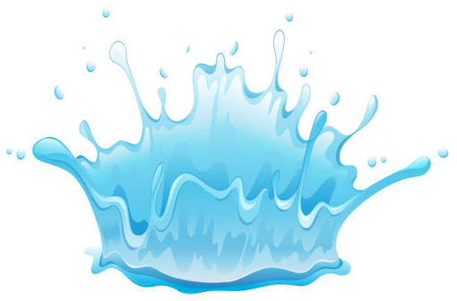

Slide 10
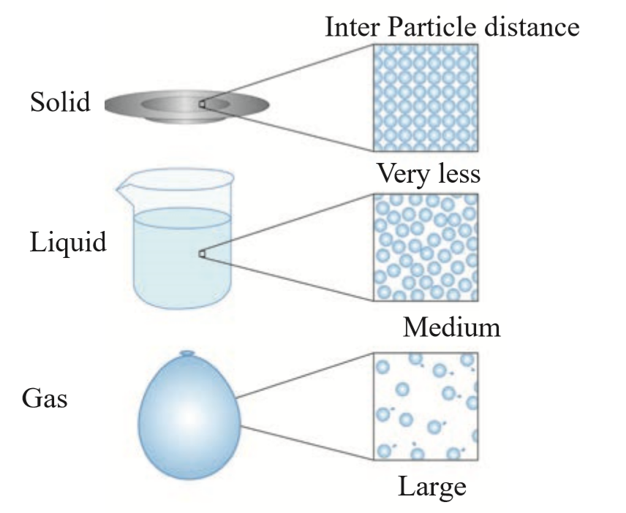
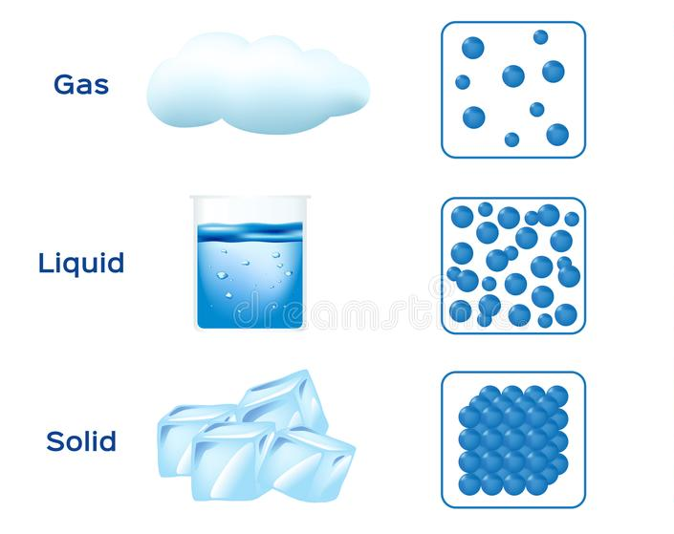
Physical state of matter : submicroscopic picture

Slide 11
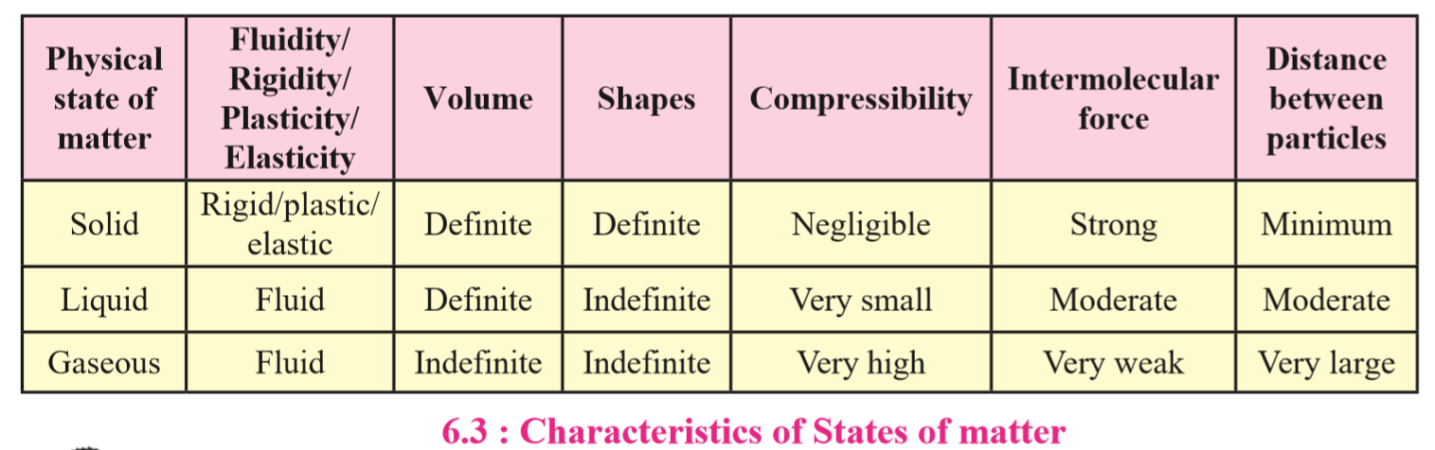

Slide 12
Name of the Material | Chemical formula/composition | Type of material
Water
Carbon
Oxygen
Air
Aluminium
Brass
Carbon dioxide

Slide 13
Name of the Material | Chemical formula/composition | Type of material
Water | H2O | Compound
Carbon
Oxygen
Air
Aluminium
Brass
Carbon dioxide

Slide 14
Name of the Material | Chemical formula/composition | Type of material
Water | H2O | Compound
Carbon | C | Element
Oxygen
Air
Aluminium
Brass
Carbon dioxide

Slide 15
Name of the Material | Chemical formula/composition | Type of material
Water | H2O | Compound
Carbon | C | Element
Oxygen | O2 | Element
Air
Aluminium
Brass
Carbon dioxide

Slide 16
Name of the Material | Chemical formula/composition | Type of material
Water | H2O | Compound
Carbon | C | Element
Oxygen | O2 | Element
Air | H2,O2,CO2,H2O, Air molecule | Mixture
Aluminium
Brass
Carbon dioxide

Slide 17
Name of the Material | Chemical formula/composition | Type of material
Water | H2O | Compound
Carbon | C | Element
Oxygen | O2 | Element
Air | H2,O2,CO2,H2O, Air molecule | Mixture
Aluminium | Al | Element
Brass
Carbon dioxide

Slide 18
Name of the Material | Chemical formula/composition | Type of material
Water | H2O | Compound
Carbon | C | Element
Oxygen | O2 | Element
Air | H2,O2,CO2,H2O, Air molecule | Mixture
Aluminium | Al | Element
Brass | Cu, Zn | Mixture
Carbon dioxide

Slide 19
Name of the Material | Chemical formula/composition | Type of material
Water | H2O | Compound
Carbon | C | Element
Oxygen | O2 | Element
Air | H2,O2,CO2,H2O, Air molecule | Mixture
Aluminium | Al | Element
Brass | Cu, Zn | Mixture
Carbon dioxide | CO2 | Compound

Slide 20
Matter is classified into three types :
Elements
Compounds
Mixture

Slide 21
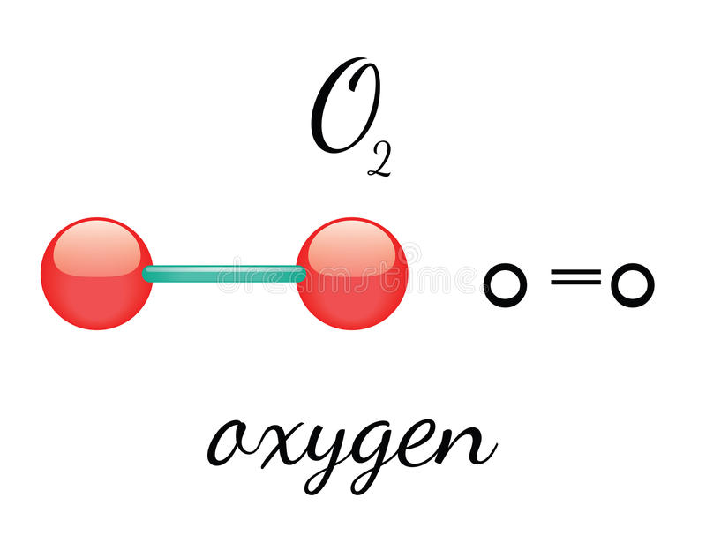
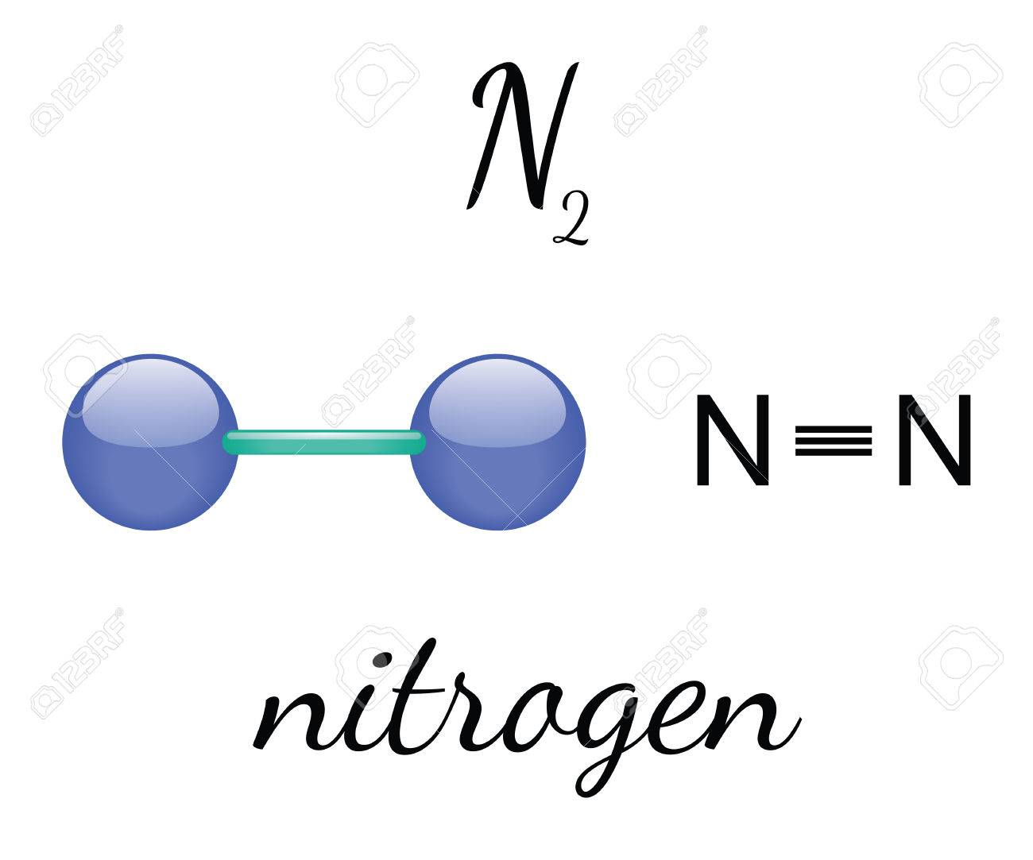
The smallest particles of an element contain identical atoms.

Slide 22
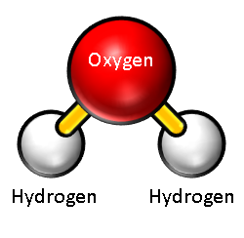
The smallest particles (molecules) of a compound are formed by joining two or more types of atoms to each
other

Slide 23
The smallest particles (molecules) of a compound are formed by joining two or more types of atoms to each
other
Water

Slide 24
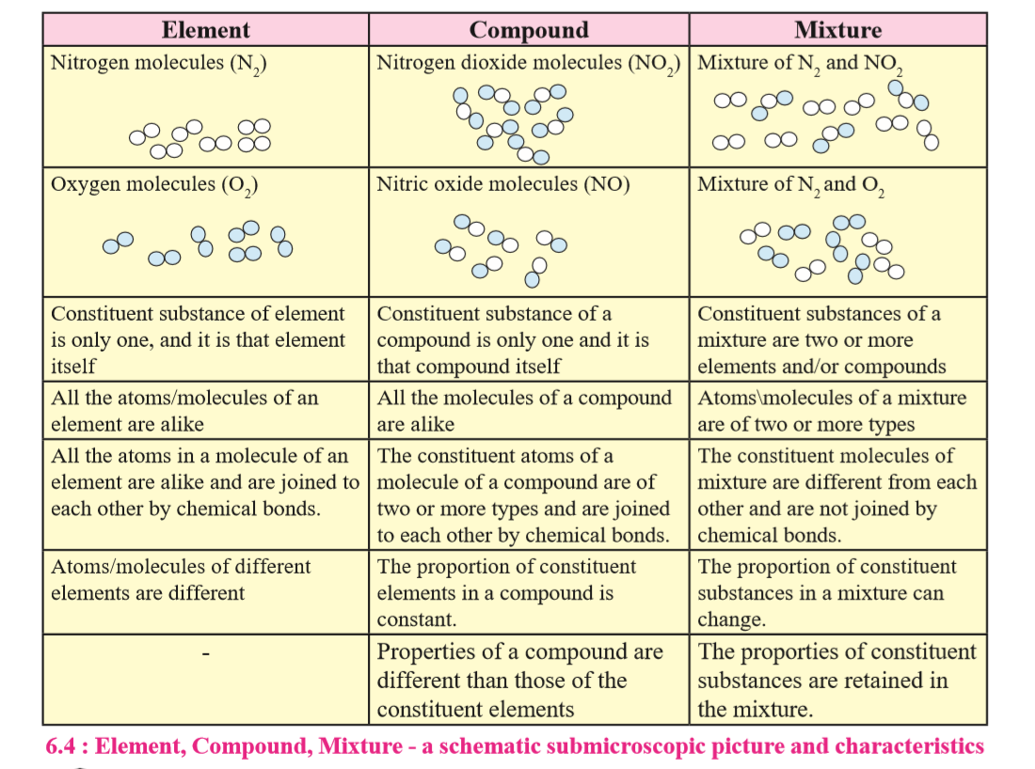

Slide 25
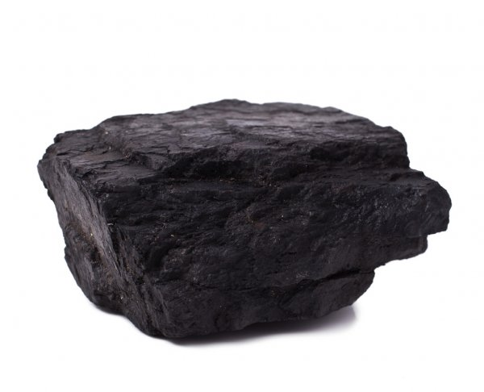
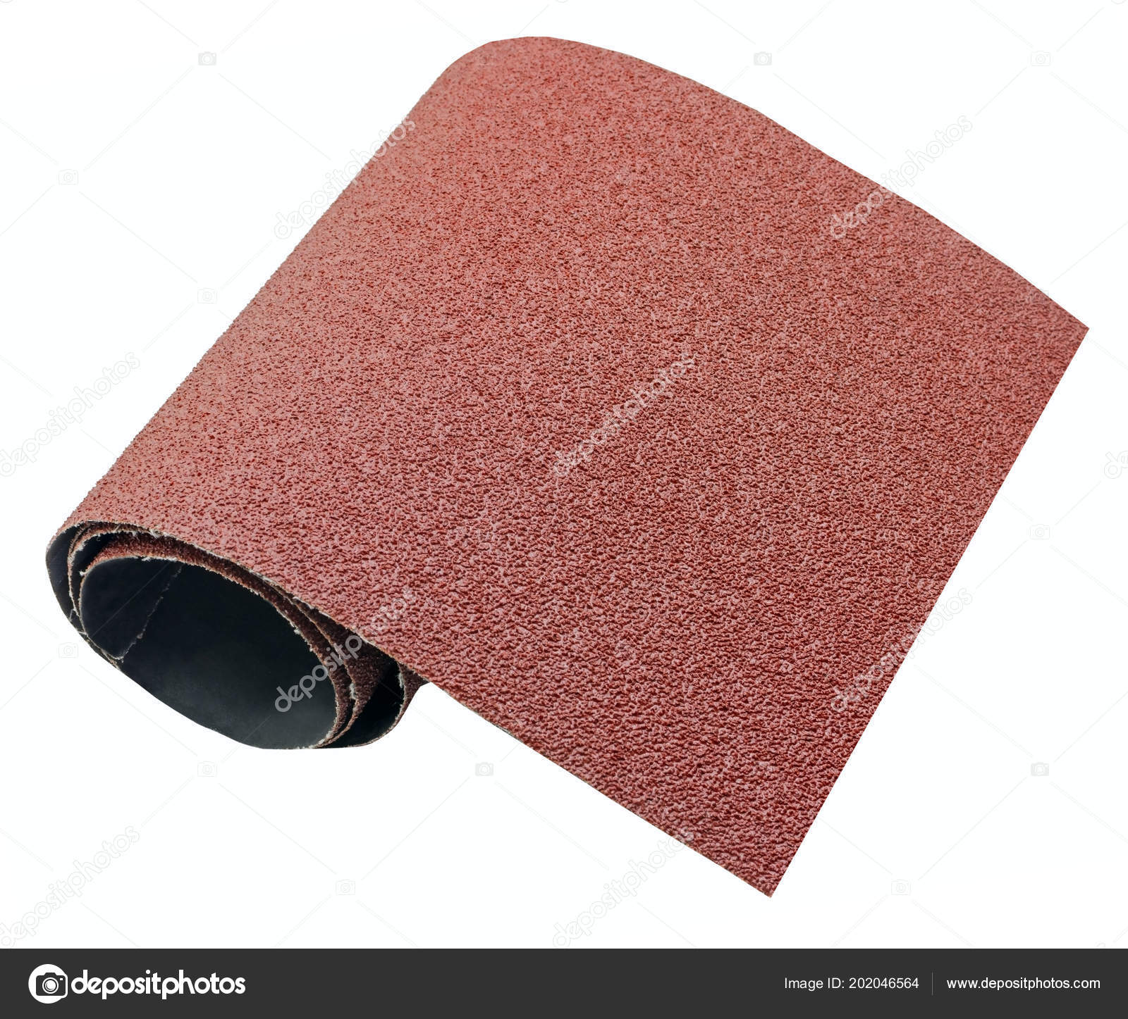
Types of elements

Slide 26
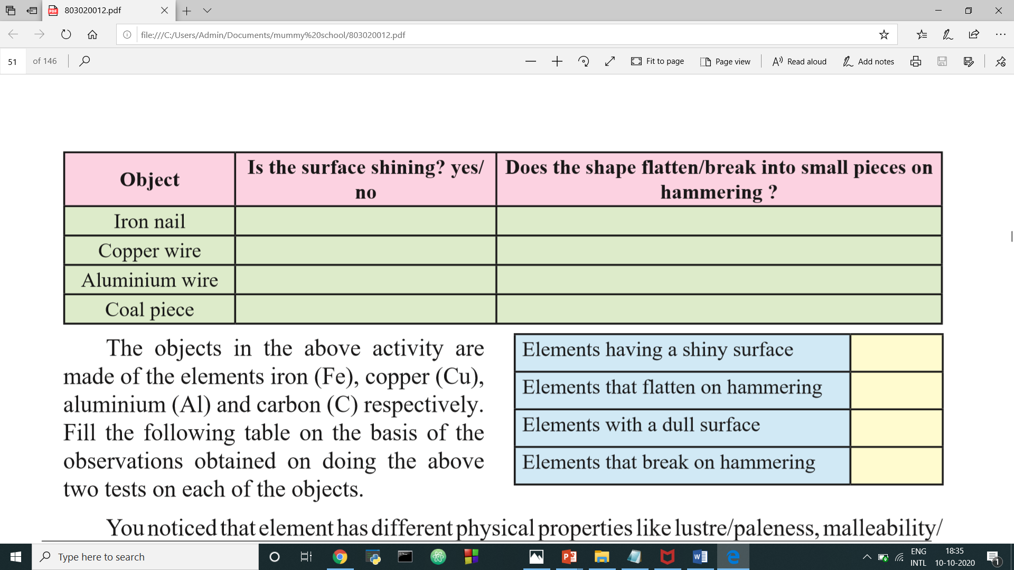

Slide 27
Yes
Flatten

Slide 28
Yes
Flatten
Yes
Flatten

Slide 29
Yes
Flatten
Yes
Flatten
Yes
Flatten

Slide 30
Yes
Flatten
Yes
Flatten
Yes
Flatten
No
Breaks into pieces

Slide 31
Iron (Fe)
Copper (Cu)
Aluminium (Al)
Carbon (C)
lustre/paleness
malleability/ brittleness

Slide 32
Elements
Metals
Non-metals

Slide 33
Metalloids

Slide 34
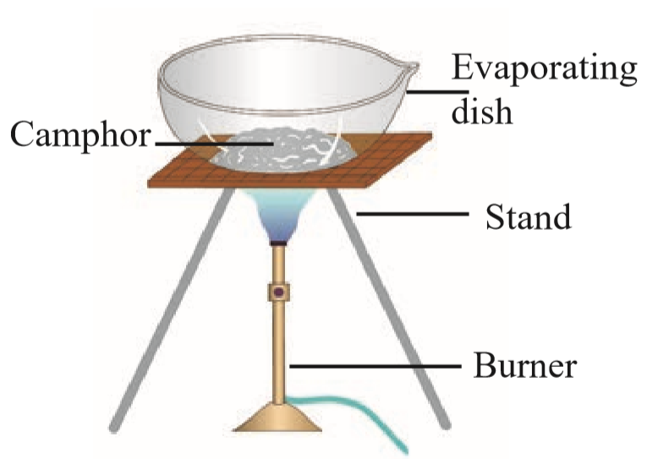
Types of Compounds
Apparatus : Evaporating dish, tripod stand, burner, etc.
Chemicals : Camphor, washing soda, blue vitriol, sugar, glucose, urea

Slide 35
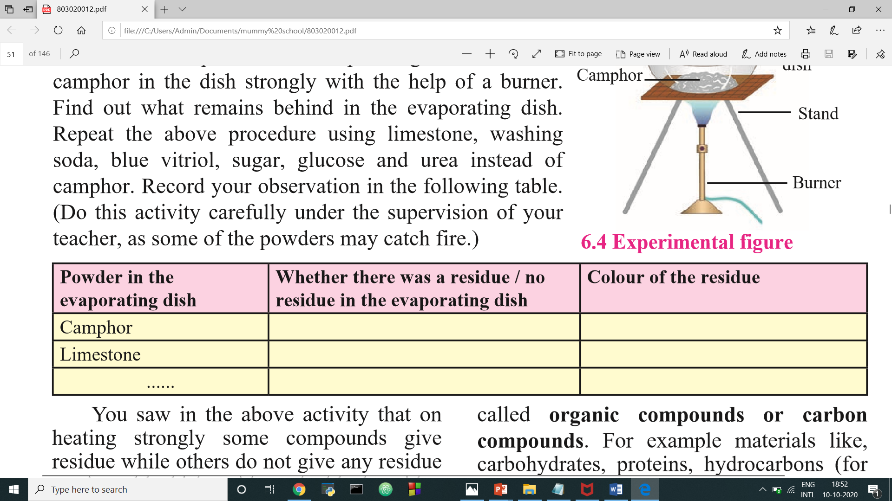

Slide 36
No residue
--
residue
White
Washing soda
residue
White

Slide 37
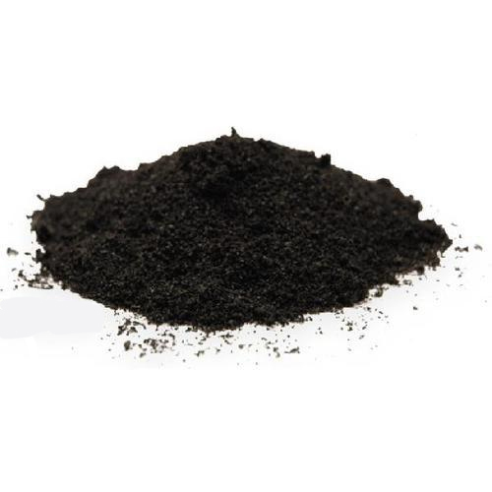
Organic Compounds Or
Carbon Compounds

Slide 38
Organic Compounds :
Comphor
Sugar
Glucose
Urea
Petrol
Cooking gas

Slide 39
Non - Organic Compounds :
The compounds that decompose on strong heating to leave a residue behind are inorganic compounds.
Common salt
Soda
Rust
Blue vitriol
limestone

Slide 40
Complex Compounds
The molecules of compounds have a complex structure formed by many atoms and in the centre of this structure metal atoms are also included. Such compounds are knoun as Complex compounds.
Chlorophyll that contains magnesium
hemoglobin that contain iron
cyanocobalamine (vitamin B-12) that contain cobalt

Slide 42
Thank You!

